Slide 1




Course Overview
Artificial Intelligence Introduction
Presented by : Mohamed Aziz ben Haha

Slide 2
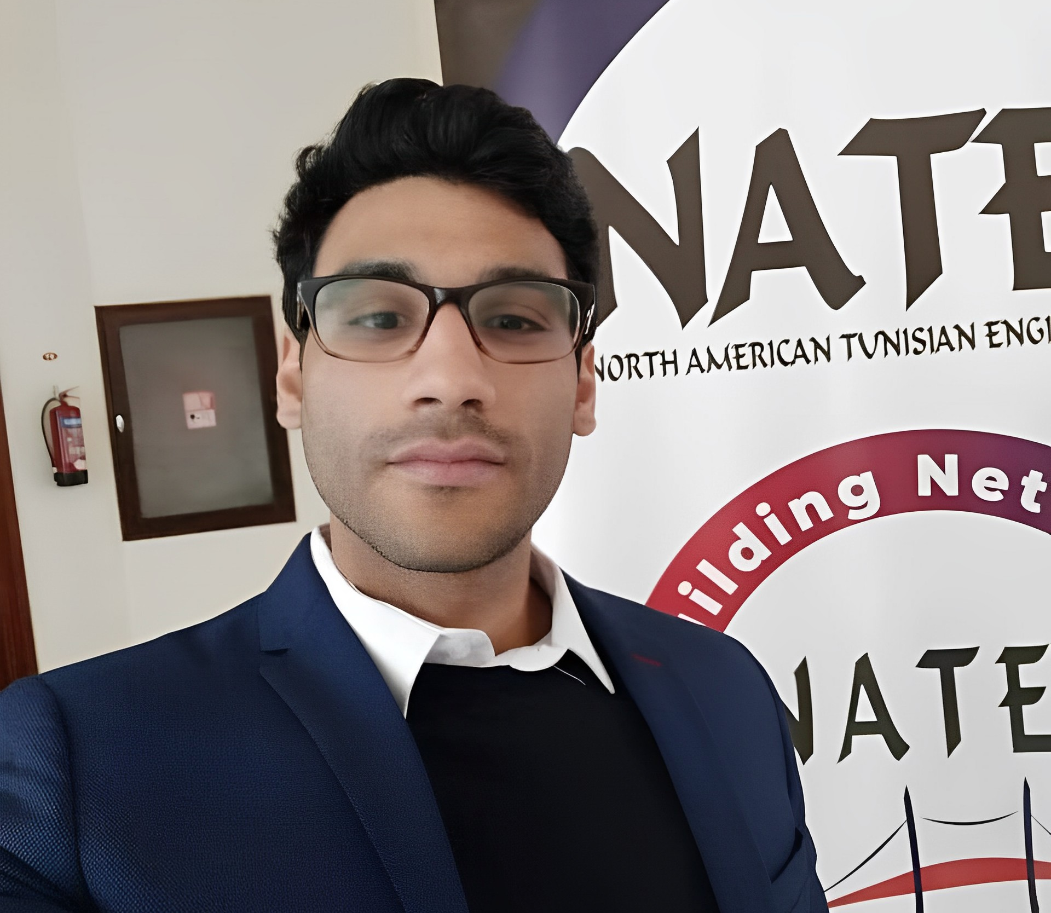




Cloud computing Engineer
Cloud computing and AI EngD. Student
As an engineer at Pass Consulting, I bring extensive expertise in cloud technologies and DevOps. Currently pursuing my doctorate in Cloud Computing with a focus on AI and blockchain integration, I combine cutting-edge academic research with hands-on industry experience.
My professional journey includes valuable teaching experience as a former instructor at TED University and professional trainer at Clevory Training, where I helped develop the next generation of IT professionals. This blend of academic research and practical industry experience allows me to bridge theoretical concepts with real-world applications.
With a deep commitment to emerging technologies, I specialize in designing and implementing cloud-native solutions while exploring the transformative potential of AI in modern computing infrastructure. My research and professional work focus on advancing the intersection of cloud computing, artificial intelligence, and distributed systems.

Slide 3

01
Learning Objectives
02
Topics Covered
03
Recommended background
04
Course Logistics & Materials
05
Class Project
06
Academic Agenda

Slide 4
Learning Objectives
This course gives a basic introduction to Artificial Intelligence (AI) and Machine Learning (ML).
Students receive an introduction to philosophical fundamental problems and ethical questions related to ML/AI, as well as the field's history. Then, study the core topics of knowledge representation, reasoning, and learning.
Later topics will include and introduction to machine learning, probabilistic reasoning, in addition to applications such as robotics, computer vision, and natural language processing.
The course covers basic supervised classification (e.g., Artificial Neural Networks), as well as unsupervised learning (Clustering), optimization (Evolutionary Algorithms and other search methods) and tentatively regression and reinforcement learning.
Through an algorithmic approach, the students are given a practical understanding of the methods being taught, in particular through making their own implementations of several of the methods.

Slide 5
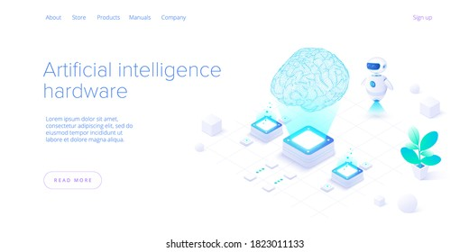
Topics Covered
Main approaches to Artificial Intelligence and Learning
Task environment
Performance measures
Intelligent Agents
Knowledge Representation
Problem solving by searching
  Uninformed search
  Informed search
  Evolutionary Algorithms
Machine Learning
  Supervised learning vs. Unsupervised learning
  Decision trees
  Neural networks
  Support vector machines
  Cross validation
Recommended background
Students who have experience with Python / Matlab, ideally some background in probability, statistics and linear algebra.
If you don’t have background in these areas, you may still sign up, but be aware that you will probably need to learn some of these items as the class goes on (pointers to references will be provided).

Slide 6

Course Logistics
Required Resources
Additional Textbooks
Stuart J. Russell and Peter Norvig, Artificial Intelligence: A Modern Approach, 3rd Edition (2010), by Pearson Education Inc.
George F. Luger, Artificial Intelligence: Structures and strategies for complex problem solving, 5th Edition (2005), Pearson Education Limited.
Wolfgang Ertel, Introduction to Artificial Intelligence, 2nd Edition (2017)
Miroslav Kubat, An Introduction to Machine Learning, 2nd Edition (2017)
Y. Abu-Mostafa, M. Magdon-Ismail, & H-T. Lin, Learning from Data - A Short Course, (2012)
Max Bramer, Principles of Data Mining, 3rd Edition (2016)
Courses are based on their counterparts in
Intelligent Systems, University of British Columbia (Dept. of Computer Science)
Introduction to Artificial Intelligence, University of Wisconsin-Madison
Artificial Intelligence, University of Illinois at Urbana-Champaign
Artificial Intelligence, University of California, Berkeley

Slide 7

What have we learned?
At the end of each section, there will be a set review activities, that would help you see the progress you've made in this lesson.
The exercises would help you:
Highlight what you have learned today and emphasize key information.
Correct misunderstandings.
Summarize, review, & demonstrate your
understanding of major points.
Transfer ideas to new situations.

Slide 8

Additional Resources
At the end of each section, there will be a short list of additional resources.
The list will include articles, YouTube videos, online courses, books ... (both Arabic and English).
These resources will provide more details on some of the topics discussed during the lectures.

Slide 9
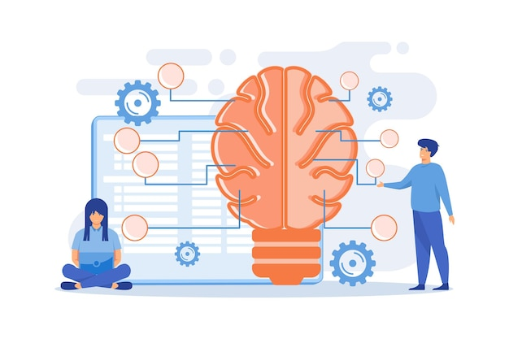
Class Project
A major component of the class goal is to take a real-world domain that you are interested in and apply the taught methodologies to gain insight into the domain.
Work to be done in groups of 4-5 students, more detail will be announced later.
Final report will include the analysis of your data, including code and visual results.
The students will be required to perform a 15 mins demo of their project.
Class projects must be focused on some real data problem.
You can discuss ideas and methodology for the homework or the project with other students in the course, but you must write your solutions completely independently.
We will be code-checking to assess similar submissions or submissions that use code from other sources.
You may use snippets of code from other sources, as long as you cite these properly (put a comment above and below whatever portion of code is copied) but be reasonable.

Slide 10
Academic Agenda
Week | Academic Agenda
Wk. 1 | Introduction to Artificial Intelligence
Wk. 2 | Intelligent Agents, AI Related Disciplines
Wk. 3 | Solving Problems by Searching, State Space Search Strategies, Structures
Wk. 4 | Knowledge Representation via Propositional, Predicate Calculi
Wk. 5 | Problem Solving as Search (Blind/Uninformed vs. Heuristic/Informed Strategies)
Wk. 6 | Problem Solving as Search (More on Heuristic Search, Adversarial Search)
Wk. 7 | Beyond Classical Search (Evolutionary/Genetic Algorithms)
Wk. 8 | Supervised Machine Learning (Decision Trees via the ID3 Algo. + BI app. via Weka)
Wk. 9 | The Learning Problem, the Perceptron, the Perceptron Learning Algo [PLA]
Wk. 10 | Multilayer Perceptron [MLP], Introduction to Artificial Neural Networks [ANNs]
Wk. 11 | Loss Functions, Weights Optimization, Support Vector Machines [SVMs]
Wk. 12 | Heuristic Optimization, Hill Climbing, Gradient Descent, Simulated Annealing

Slide 11

Thank you for your attention !
Any questions ? ( I love them )
Bento.me/mohamed-aziz-ben-haha
mohamedaziz.benhaha@supcom.tn

